Slide 1
Distance and Time

Slide 2
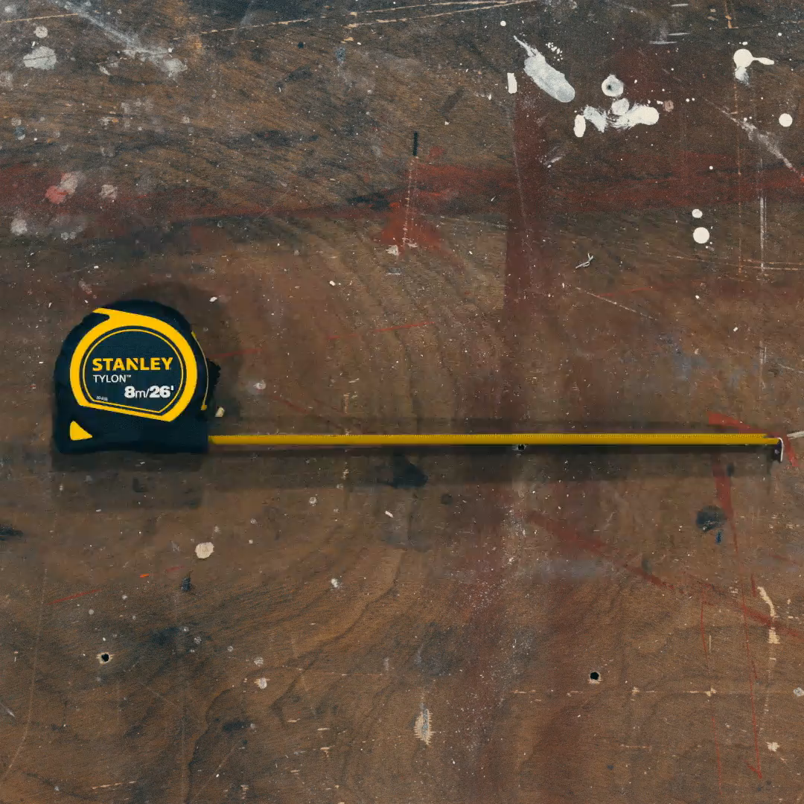
By the end of this lesson, you should be able to:
Identify the units of distance and time.
Recall how distance is measured.
Recall how time is measured.

Slide 3
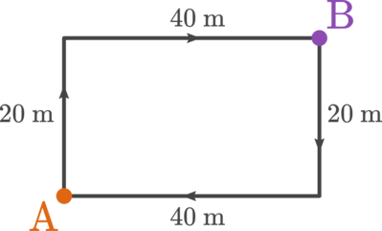
The distance an object travels is the amount of ground it covers.
For example, you may want to know the total distance you travel as you walk from home (point A) to school (point B). It's handy to have a map showing your path, like this:

Slide 4
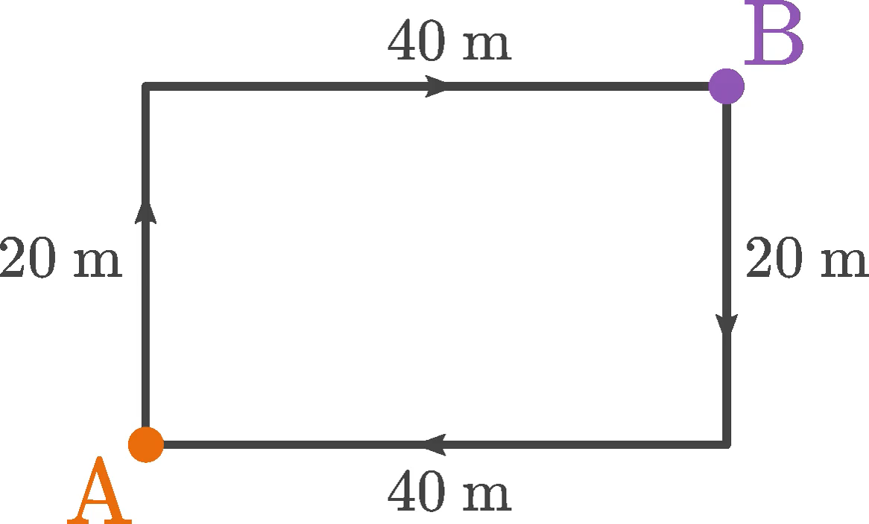
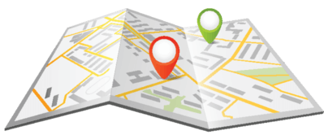
Calculating total distance.
To find the distance between A and B, you need to add 20 m to 40 m. This means you covered a total distance of 60 m.
20 m+40 m=60 m

Slide 5
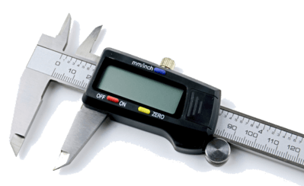
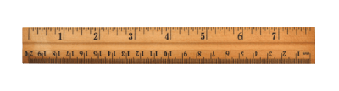
Units of distance.
Distance is measured in the unit of metres (m). You can measure distances with a ruler, a measuring tape or if you need high precision, a digital caliper.
Distance is a scalar quantity. This means that the distance you walk has a size or magnitude, but the direction you walk in doesn't matter.

Slide 6


Slide 7
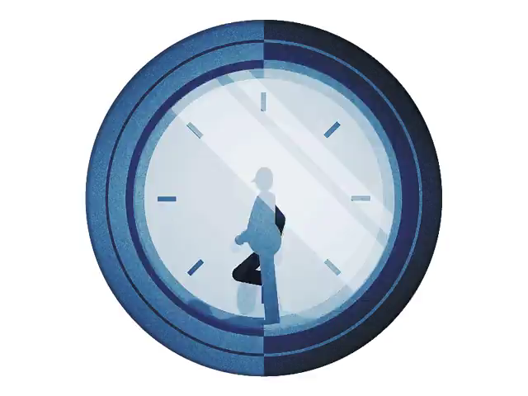
Time is always moving forwards.
Time only goes in one direction; forwards. It cannot travel backwards.

Slide 8
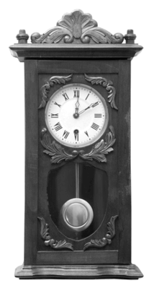
How do we measure time?
We use tools like clocks and calendars to measure it. The measurement of time is an extremely important concept for the rest of the work we will do in this module!

Slide 9
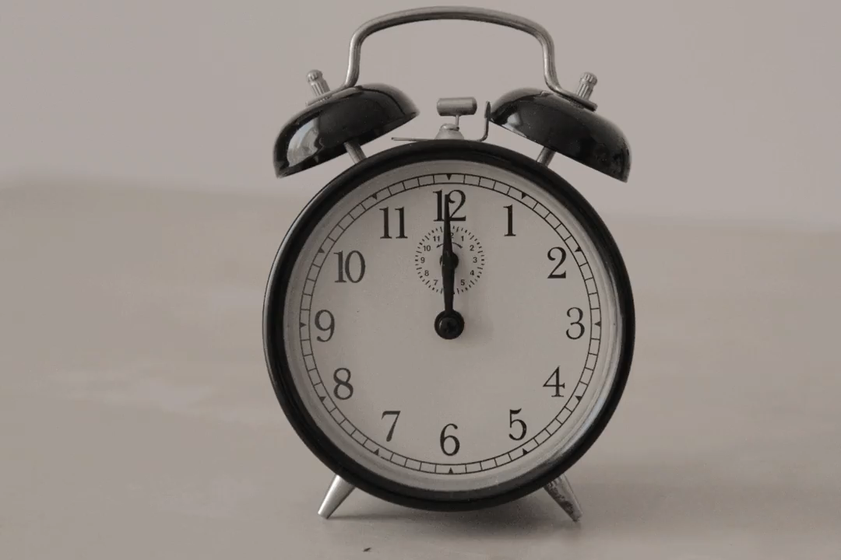
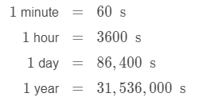
What units can time be measured in?
You should already know that the second (s) is the standard unit of time. The more seconds tick by, the more time is passing. We can define larger amounts of time by the number of seconds they contain. For example:

Slide 10
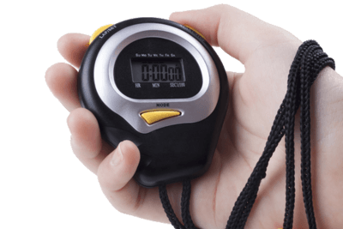
How accurately can time be measured?
The most accurate way to measure time is with an atomic clock, like the NIST−F1 clock in Colorado, USA. Seeing as most people don't have a spare billion dollars to spend, they use stopwatches and other timekeeping instruments.
You can use a digital stopwatch like this to measure how long something takes to happen. For example, if your friend is running a cross-country course, you can find out how many seconds (s) it takes them to reach the finishing point.

